Slide 1
Is gasoline price a good indicator of Consumer Spending?
Christina Bastien Perrault
Juan R. Ulloa
Clément Boit

Slide 2
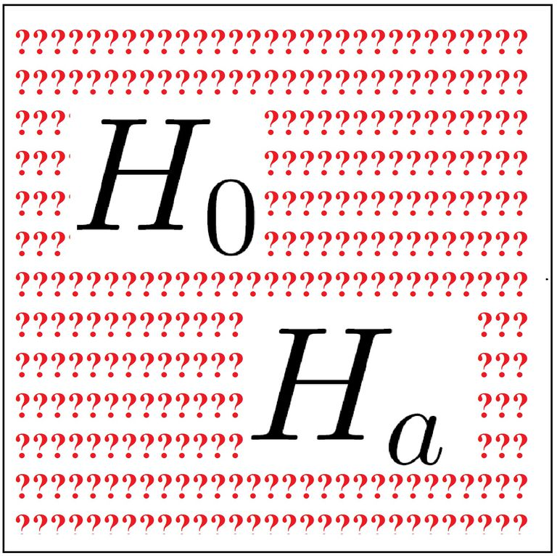
Research Question, Null and Alternative Hypothesis
What is the relationship between the price of gasoline and consumer spending for durable goods, non-durable goods and services?
Null: We hypothesize that there will be a not be a negative relationship between the price of the gasoline and the amount of money spent on consumer consumptions in the durable, non-durable and services categories.
Alternative: We hypothesize that there will be a negative relationship between the price of the gasoline and the amount of money spent on consumer consumptions in the durable, non-durable and services categories.

Slide 3
Summary Findings
All States: No relationship between our variables (very low rvalue)
5 states with highest per capita income: Negative relationship between our variables (negative rvalue)
5 states with lowest per capita income: Negative relationship between our variables (negative rvalue)
We reject our null hypothesis for the 5 states with high per capita income and 5 states with low per capita income
We fail to reject our null hypothesis for all the states

Slide 4
Variables
Gasoline Price
Per Capita Income: To target states with high income per capita and low income per capita
Money spent on durable goods
Money spent on nondurable goods
Money spent on services
Notes:
Why did we choose

Slide 5
Definitions of Category
Durable Goods: Items not for immediate consumptions (appliances, electronics ect.)
Non-Durable Goods: Items for immediate consumptions (food, beverages, gasoline)
Services: Hard to figure out from website

Slide 6
Data Extraction
Consumer Consumption:
https://apps.bea.gov/iTable/iTable.cfm?reqid=70&step=1&acrdn=7#reqid=70&step=1&acrdn=7
Personal Income per state:
https://apps.bea.gov/iTable/iTable.cfm?reqid=70&step=1&acrdn=8
GDP per state:
https://www.bea.gov/data/gdp/gdp-state
Retail oil prices: API KEY:
http://api.eia.gov/category/?api_key=0153adcb87f49b02f773e395a39ca985&category_id=714757
CSV file import (population, income, spending per category)
API call to grab cost of gasoline per year and per state.

Slide 7
Data Cleaning and Exploration
Pandas dataframe to clean data
Merge different datasets: Population, Income and GDP to be able to get per capita income and per capita GDP
Merge list of states with cost of gasoline
Merge spending per category with cost of gasoline
Renamed columns to make merging easily
Problems
Github
Workaround: Saved local folder as backup and worked in one branch ☺
Merging two notebooks together
Workaround: Dataframe in onenotebook → Saved as CSV file → Import CSV to other notebook
Figure out which graph to plot. So many variables.
Workaround: Stay focus
Understanding the API as there were no documentation on how to use and calling the JSON:
Workaround: Internet troubleshooting

Slide 8
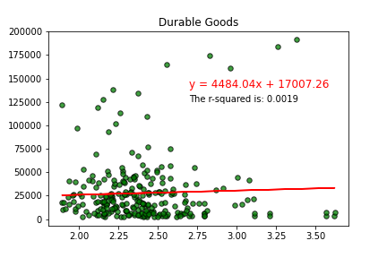
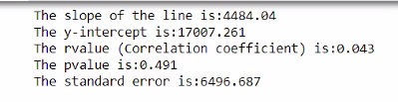
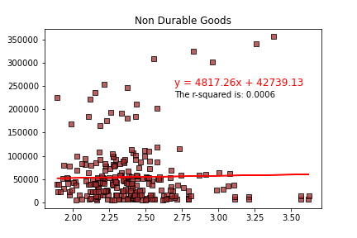

All States - Durable and Nondurable Goods vs. Oil Price per gallon
Data Plotting

Slide 9
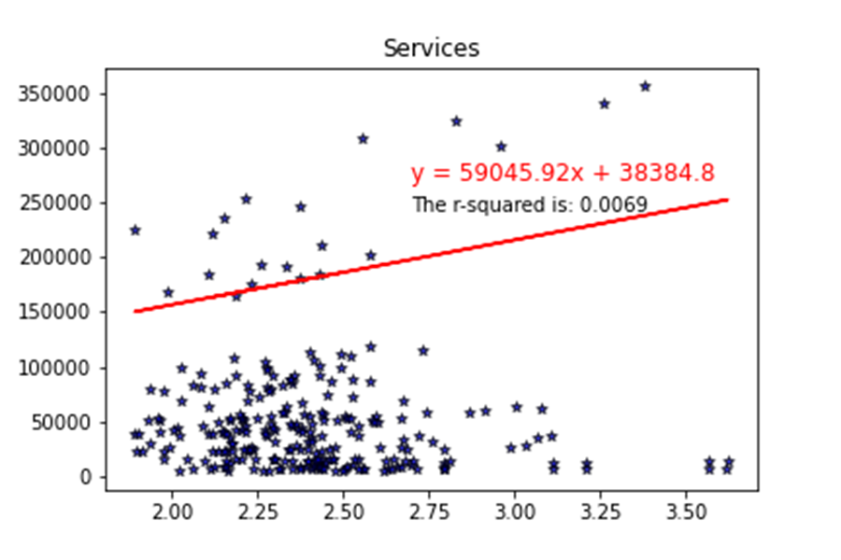
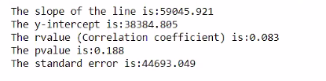
All States - Services vs. Oil Price per gallon
Data Plotting

Slide 10
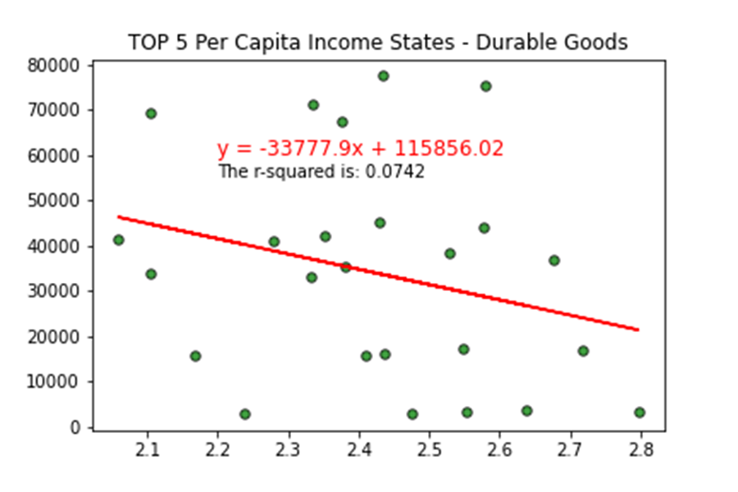

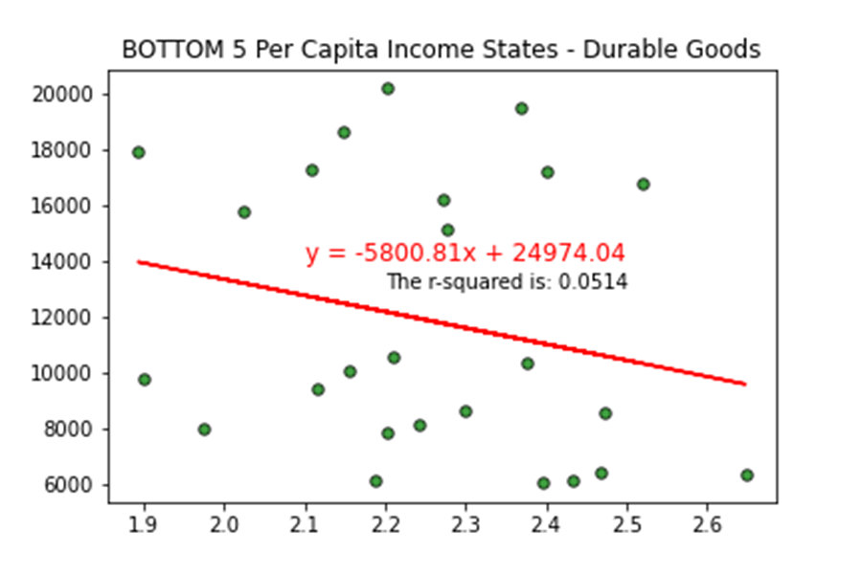

Durable Goods vs Oil Price per gallon – 5 states with top per capita income and 5 states with bottom per capita income
Data Plotting

Slide 11
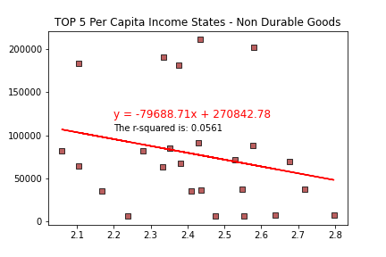

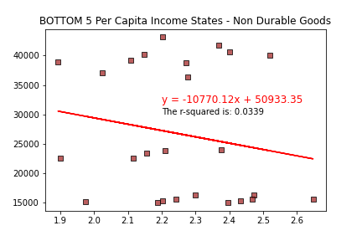

Non-Durable Goods vs Oil Price per gallon – 5 states with top per capita income and 5 states with bottom per capita income
Data Plotting

Slide 12
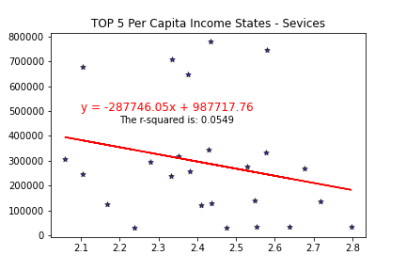

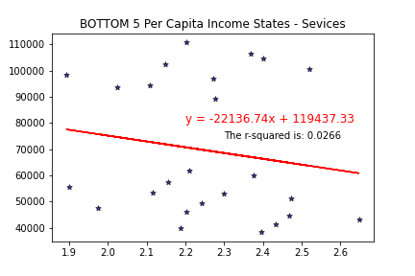
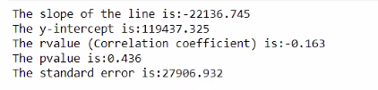
Services vs Oil Price per gallon – 5 states with top per capita income and 5 states with bottom per capita income
Data Plotting

Slide 13
Data Analysis
Ten states chosen to separate our outliers from the main population (all states): Based on per capita Income (top and bottom)
High standard error = Inaccurate representation of the mean of the population.

Slide 14

Data limitations
We wanted to use 2020 numbers as they will tell a great story of the impact of COVID on the categories we chose and how they might be related or not to the price of gasoline. No 2020 numbers yet.
What are the services when you think of consumer consumption?
No definition of services on website.

Slide 15

Data Discussion
We found what we expected for the outliers (negative relationship). We didn't expect the correlation between the states to be so low for all the states in the US.
This points out the income gap among the states
In 2020, there might be a spike in the dollars spent on nondurable goods as more individual purchased medicines and other items to deal with COVID-19. This might impact the relationship between money spent on goods vs. oil prices.
If we had more time, we would have wanted to research:
How gas price affect consumer spending over the years. (Grab more years for analysis)

Slide 16

Any Questions?

